Slide 1

Hand Gesture Recognition
Under the supervision of Prof. Neha Jain
Ashish Roy

Slide 2
Introduction
The essential aim for building this project is to learn to create a natural interaction between human and computer where the recognised gesture can be used for conveying meaningful information.
This is just a basic step of recognising a hand gesture or rather say count the number of fingers.

Slide 3
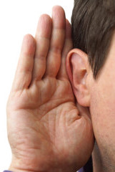
Problem Statement
Imagine yourself a Deaf person
How would you express your feelings, thoughts and ideas?
We will be able to deliver them right and easily
Handicap people represent a large scale in our community, we should take steps to be able to communicate with them to share knowledge, thoughts, ideas and even feelings
So we want to create a communication mean that we can use to do so

Slide 4
Technical Overview
Packages used :
Open source Computer Vision Library (OpenCV)
It is an open source computer vision and machine learning software library
which is designed for computational efficiency and with a strong focus on
real-time application.
NumPy
NumPy is the fundamental package for scientific computing with Python.
a powerful N-dimensional array object.
sophisticated (broadcasting) functions.
tools for integrating C/C++ and Fortran code.
useful linear algebra, Fourier transform, and random number capabilities.
Math
It provides access to mathematical functions

Slide 5
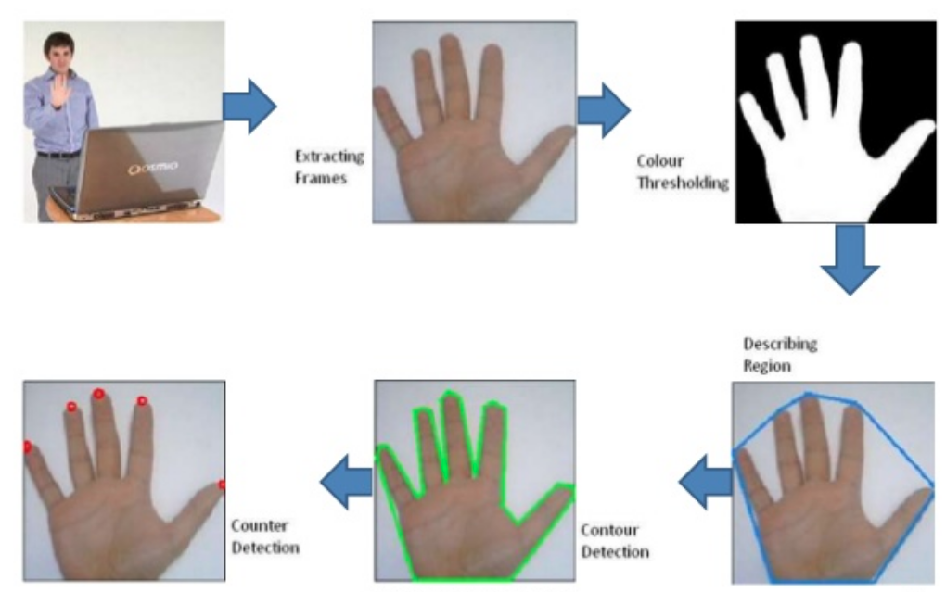
System Flow

Slide 6
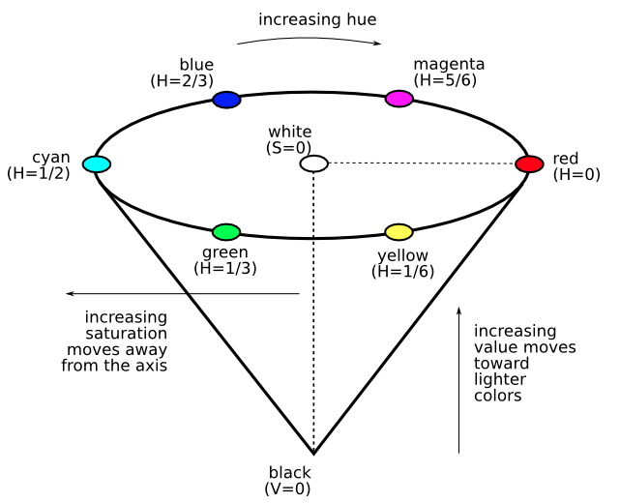
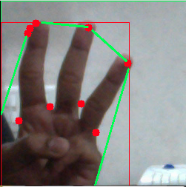
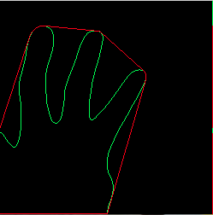

Image Transformation
Frame Extraction
Gaussian Blur
RGB to HSV
Colour Thresholding
Blob Detection
Polygon Tracing

Slide 7
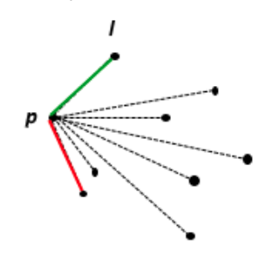
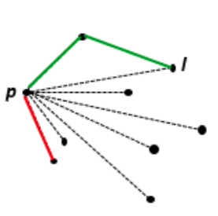
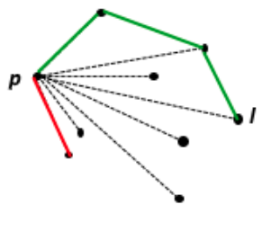
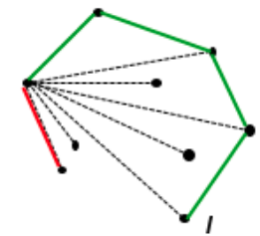
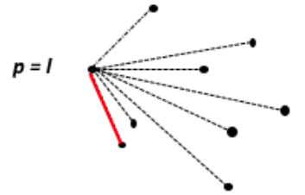
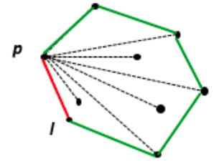
Algorithm Used
Convex Hull Algorithm (Jarvis’s Algorithm or Wrapping):
Given a set of points in the plane the convex hull of the set is the smallest convex
polygon that contains all the points of it.
p

Slide 8
Counting Fingers
Once the Polygon is traced, the number of blobs inside the Polygon is taken in consideration, the outer ones are ignored.
If, the blob inside the Polygon makes an angle less than 90 degrees with the nearest two points of the polygon, then the point is stored in a tuple and marked as DEFECTS.
This number of Defects minus one are equal to the number of Fingers.

Slide 9
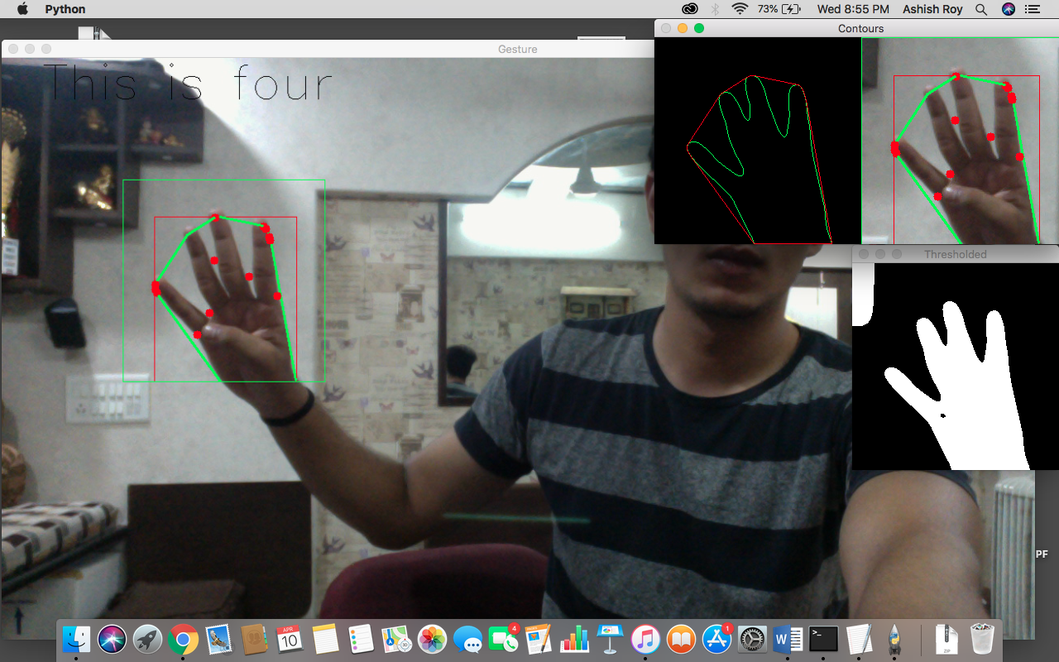

Slide 10
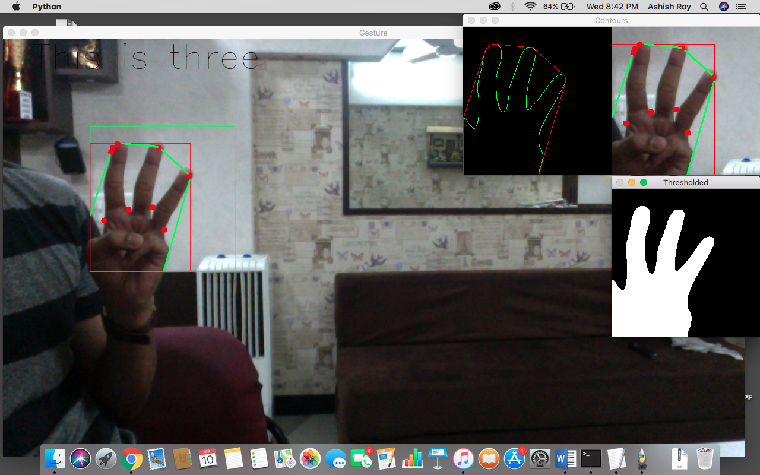

Slide 11
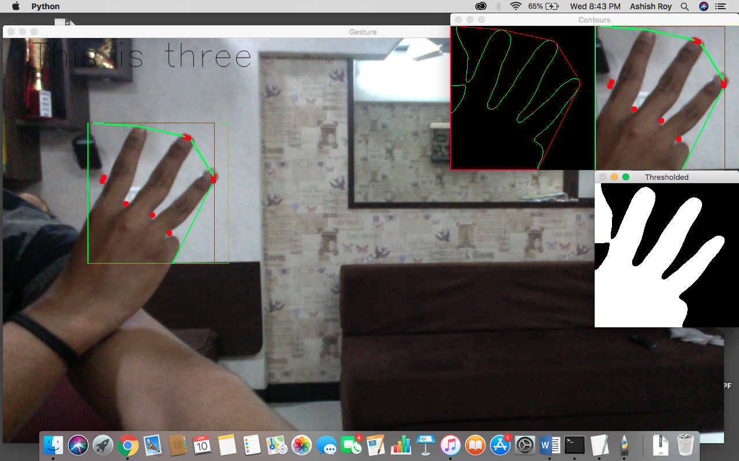

Slide 12
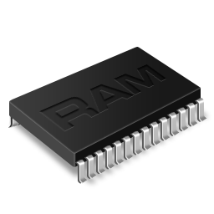

System Requirements
Laptop Camera or WebCam (320x260)
Processor - 400MHz or above
RAM - 512MB or above
Hard Disk - at least 250MB free

Slide 13
Thank You!

